Slide 1
Walmart supply chain management Name Course Institution Date

Slide 2
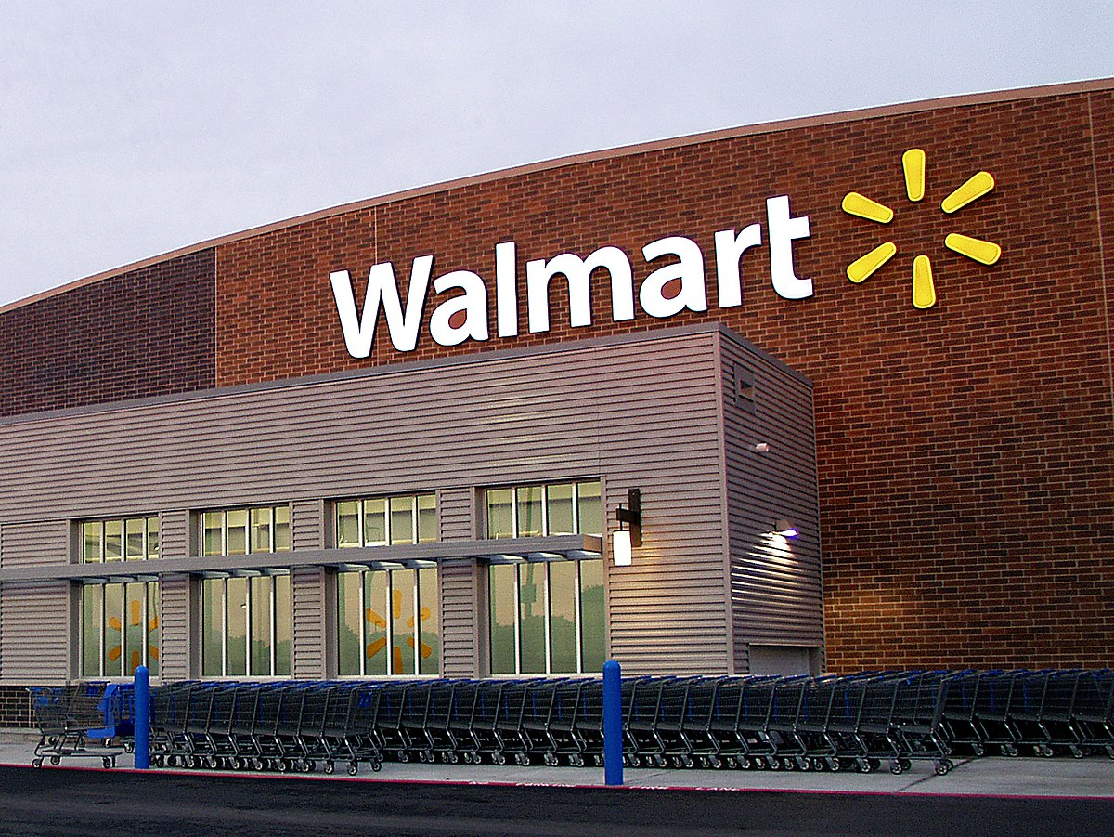

Slide 3
Introduction
Walmart Inc. is the world's biggest retailer
Supply Chain Management is the primary means by which Walmart company expands and achieves its position.
Walmart Inc. has continued to gain a large share of the US stock exchange
Other retailers are copying their logistics and supply chain tactics, such as exchanging sales data with vendors, deploying RFIDs and bar codes, allowing in-house transit self-distribution and maintaining inventory levels through a truly digital point of sale.

Slide 4
Description of the Supply Chain
Sam Walton had an effective network of shops before he began the Walmart Inc. Stores chain in 1962
Walmart Inc. expanded in the 1960s and 1980s
Walton's purchasing power expanded
Walmart Inc.'s facilities are closer to each store's real-time information processing systems - inventory can be automatically distributed in the shops
Walmart Inc. assists its clients with regards to some product types

Slide 5
When a commodity is ready to be distributed at the point of sale, the retail plan should be developed, since goods are typically sold in bulk at these locations. The retail plan encompasses all activities, from logistics to store level, which aids in the reduction of operational costs.
Walmart Inc. is well-known for implementing the Just-in-Time process of their supply chain management, which eliminates excess expenses by stocking large quantities of goods that are not required.
Walmart Inc. has historically been better than its rivals because it has forged the best partnerships with all kinds of vendors, customizing processes and offering a broad marketplace for brands to sell.

Slide 6
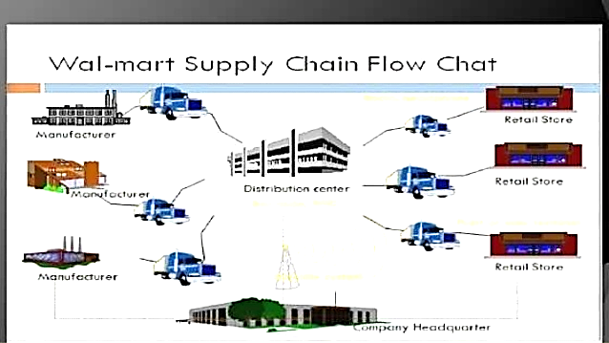

Slide 7
Strengths of the Business
Fortune Magazine recently rated it number one in revenue
Walmart's attributes are all linked to the scale of the company
The company's strategic strengths allow it to overcome threats
Such organizational and market attributes, provide a competitive edge, especially towards smaller retailers.

Slide 8
Walmart Inc. Weaknesses
Walmart Inc. is concerned with a number of issues. These can be classified into the following categories: Extensive labor rights concerns, government relations issues, and other public relations issues.
The organization is generally resistant to unionized labor - Labor unions point to pay problems, change management, and infringement of worker freedom.
Other public image issues range from zoning violations to detailed concerns from Walmart Inc. rivals that claim the company is abusing its control.

Slide 9
The condition of the supermarket market, as well as variations in consumer perceptions of the products they buy, are posing problems for Walmart.
These factors should require the corporation to undertake the operational adjustments required to continue effective.
These weaknesses are connected to the company's overall approach and how it impacts market growth, skills, finances, and profit margins.

Slide 10
Alternatives Strategies
Walmart Inc. is experiencing a banner year, having risen to the top of the Fortune 500 chart.
Most people in the supermarket sector view the business as a dictator but Walmart Inc. has the choice of adopting a friendlier organizational approach as an alternative strategy.
Countless anti-Walmart Inc. activist organizations have come up to drive the corporate behemoth out of local neighborhoods.

Slide 11
Walmart Inc. enjoys donating funds to charity and claiming to do well. They must take a more involved role in this work rather than merely donating money to organizations like the United Way.
Walmart Inc. should send shop managers and executives into local areas to donate their resources in a positive way.
It would also be beneficial if salaried store managers were allowed to collaborate on community events after work hours rather than being encouraged to do so on their own.

Slide 12
Walmart's Opportunities
Walmart's opportunities are mostly focused on expanding its business and improving its operating practices.
Walmart's desire to invest in developing countries is determined by their level of economic growth
Walmart Inc. got into trouble in Germany, where it tried to reduce all of the costs below those of its rivals. This is against the law in Germany, where government price manipulation is popular. Walmart Inc. was finally able to get around the statute, but this did not leave Germans comfortable.

Slide 13
Alternatives Evaluation and Recommendations
Walmart Inc. is adamant that the best path to advance is to establish long-term partnerships with vendors so that knowledge exchange is more secure and easy.
Aside from these routes, the transit system is very effective, and their buses are equipped with special navigational devices that help them maintain track of their transportation system.
Walmart Inc. uses a structure through which the delivery center is explicitly connected to the shipping group, and the actual warehouse is linked to the shipment party as well. It raises operational costs since one shipment is connected to the delivery center, and when an order is placed, it is picked, packaged, and delivered separately to each store site.

Slide 14
Implementation
Walmart Inc.'s public relations campaign would continue to render these policy priorities a reality.
Gaining connections to policymakers who will support Walmart Inc. in meeting its targets is also part of the public relations policy.
The public relations campaign may also counter the critical feelings held by certain groups who believe Walmart Inc. is infiltrating many more supermarket markets than it should.
For Walmart Inc. is to continue to enjoy strong market awareness, these issues must be resolved.
If Walmart Inc. is to stay at the top of game, whilst still retaining a positive image and making the brand associated with affordable rates and high-quality products, it would need to enforce these guidelines.

Slide 15
Control and Evaluation
The importance of strategy implementation is similar to, if not greater than, that of strategic preparation.
The moment that the team brings all of their brainstorming and analysis to use in order to render the company profitable is called strategy execution.
Walmart's multinational policy is to encourage the company to become more internet-connected.

Slide 16
Walmart's global expansion plans include Latin America and Asia. Walmart has investigated and learned the history, traditions, practices, and other aspects of the countries where they intend to operate in Latin America and Asia in order to be able to draw shoppers from all over the world, and would provide goods to satisfy consumer demand.
Walmart can keep track of the effects their supermarkets have had in these countries, as well as the health of their market by matching sales against expected revenue.

Slide 17
Ethics and Governance
When introducing a new business policy, it is critical to consider how governance can affect the plan, as well as what ethical problems will arise.
Walmart must be mindful of the laws that regulate companies utilizing the internet for sales purposes, since our strategic strategy advocates for the internet to expand our consumers' awareness.
It must therefore be acquainted with the rules of the states with which it conducts business - Walmart is a socially significant corporation.

Slide 18
Strategic metrics are used to see whether the company's strategic approach has to be tweaked or whether it's operating as intended. The main aim of computing market indicators is to monitor administrative costs, but the overall goal is to convey a company's progress against long- and short-term objectives.
A capital ratio informs a firm of its capacity to satisfy short-term financial commitments. Asset turnover rates indicate how well a company uses its assets. Financial debt rates indicate a company's long-term financial stability.
Different measurements of a company's capacity to earn income are expressed by profitability ratios. The next move after completing strategy preparation is to bring the proposal into action.

Slide 19
Conclusion
Walmart Inc. is the largest employer in the United States and ranks first among Fortune 500 companies.
Walmart Inc. is a multinational corporation that exists in several countries and expands into new ones every year.
Because of Walmart Inc.'s ever-increasing scale and range of services, their public relations department would become more relevant.
Walmart must prioritize leveraging its assets to leverage opportunities in the competitive retail industry.
Weaknesses and risks to the enterprise can be seen as secondary concerns. Walmart's HR management standards and merchandise consistency standards will all be strengthened to boost the company's efficiency.

Slide 20
References
Bank, M. C., Kenny, B., & Stecher, A. (2018). Walmart in the Global South: Workplace culture, labor politics, and supply chains. Austin : University of Texas Press
Chopra, S. (2019). Supply chain management: Strategy, planning and operation. New York, NY : Pearson Education
Collinson, S., Narula, R., Rugman, A. M., & Qamar, A. (2020). International Business, 8th Edition. Harlow, United Kingdom: Pearson Education, Limited.
Gimuriman, R., Novack, R., & Schreyer Honors College. (2018). From brick to click & click to brick: The retail e-volution. University Park, Pennsylvania: Pennsylvania State University
Inc, G. R. (2019). Encyclopedia of Major Marketing Strategies. Farmington Hills: Cengage Gale.
John, M. T., James, B., & Ram, S. (2019). A Business Ethics Supply Chain Case Study of Publix Super Markets and the Coalition of Immokalee Farmworkers’ Fair Food Program. 1 Oliver's Yard, 55 City Road, London, EC1Y 1SP, United Kingdom: SAGE Publications
Kopnina, H., & Blewitt, J. (2017). Sustainable business: Key issues. London New York, NY: Routledge
Madara, D. (2020). How Walmart Inc can successfully enter Singapore market. München GRIN: Verlag
Qiu, M. (2018). Smart Blockchain: First International Conference, SmartBlock 2018, Tokyo, Japan, December 10-12, 2018, Proceedings.
Ramadani, V., Memili, E., Palalić, R., & Chang, E. P. C. (2020). Entrepreneurial family businesses: Innovation, governance, and succession. Cham: Springer.
Swanson, C., & Kling, T. L. (2020). Gracious and strong: How to rise above the unexpected left turns of life and leadership. Franklin, Tennessee : Cloverleaf Publishing

